Slide 1
Intro to C++ Basics
DSA-II LAB

Slide 2
Why C++ ?
Everything you did in C can be done using C++
We are using this language so that we can easily perform certain tasks (e.g sorting)
Get acquainted with object oriented programming
More flexibility in implementing certain algorithms

Slide 3
What we will learn about C++ ?
The basic concepts that are sufficient for implementing the algorithms.
Standard Template Library.

Slide 4
Lets see the differences between a C and C++ program
Topics we will cover
namespace, cout, cin
class and object (you can think of these as extended structures)
constructors and destructors
string class
new and delete (similar to malloc and free)
passing objects to functions
Standard Template Library
Some OOP concepts you will learn later

Slide 5
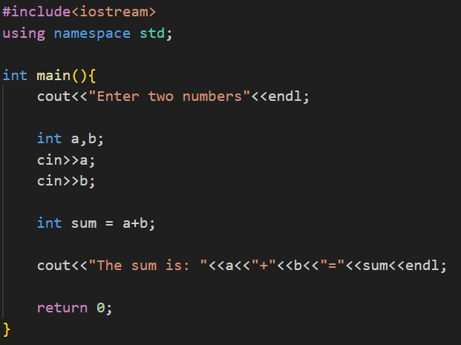
namespace, cout, cin
Consider the following C++ code.

Slide 6
namespace, cout, cin
iostream
A header file in C++ that provides functionalities for input and output operations.
Includes definitions for standard input/output stream objects.
namespace:
A feature to organize code into logical groups and prevent name conflicts.
std is the standard namespace that includes C++ library features like cin, and cout.
cin:
An object used for taking input
cout:
An object used for providing output

Slide 7
class and object (you can think of these as extended structures)
Let us create an object called person.
A person will have the properties :
Date of birth
Birth month
Birth year
name
A person can say his name (we will just print it here)
A person can say his dob (we will just print it here)

Slide 8
class and object (you can think of these as extended structures)
Note :
In C we could create structures, but
Structures only had variables in them
Structures did not include functions
In C++ we can also create structures as well as class
They include both variables and functions
They can also include other class objects too

Slide 9
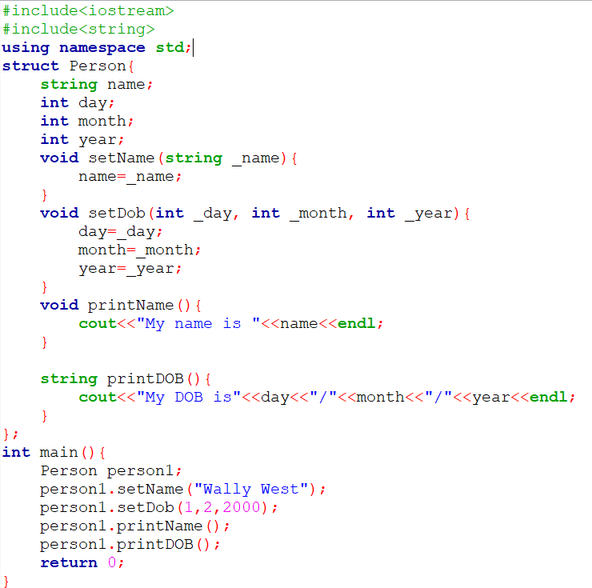
class and object (you can think of these as extended structures)
Wait! Where is the class?

Slide 10
class and object (you can think of these as extended structures)
Let us use a class now
What does it mean by public?
What does it mean by private?
What does it mean by protected?

Slide 11
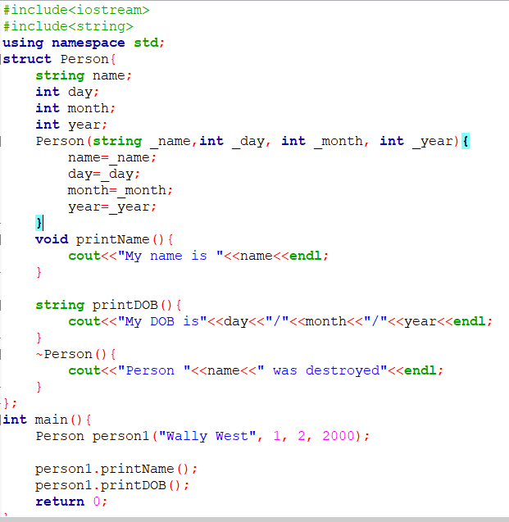
Constructor and Destructor
Constructors
Called when an object is created
Used for initialization
A default constructor must be there
Destructor
Called when the object is destroyed
i.e when the memory is freed

Slide 12
Lets see the differences between a C and C++ program
Topics we will cover
namespace, cout, cin
class and object (you can think of these as extended structures)
constructors and destructors
string class
new and delete (similar to malloc and free)
passing objects to functions
Standard Template Library
Some OOP concepts you will learn later

Slide 13
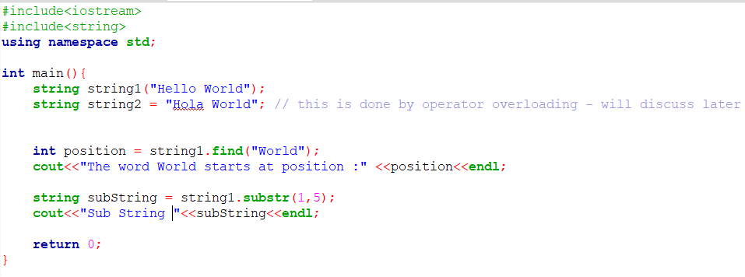
string class

Slide 14
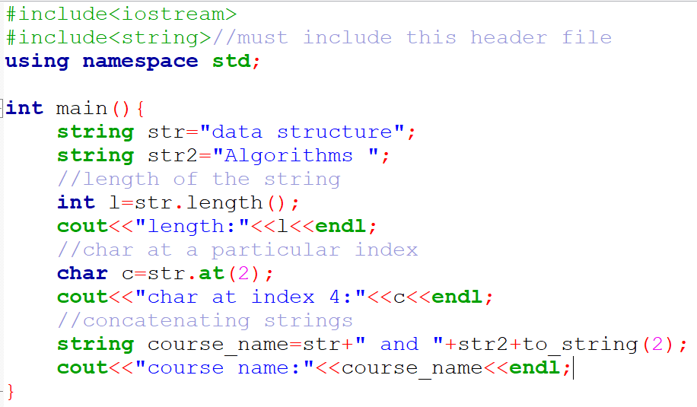
STRING FUNCTIONS in C++

Slide 15
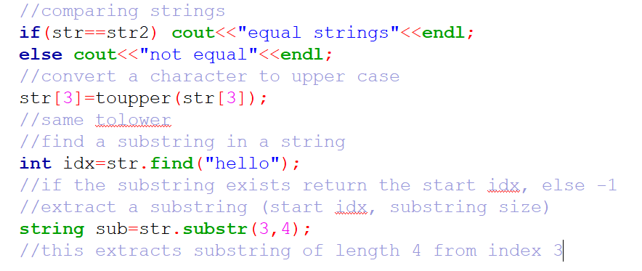
STRING FUNCTIONS in C++

Slide 16
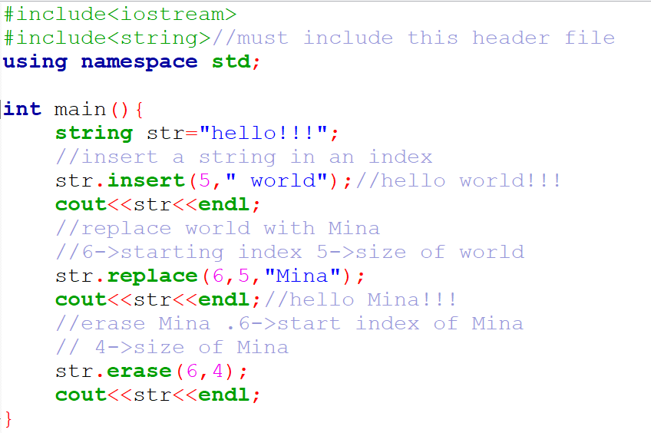
STRING FUNCTIONS in C++

Slide 17
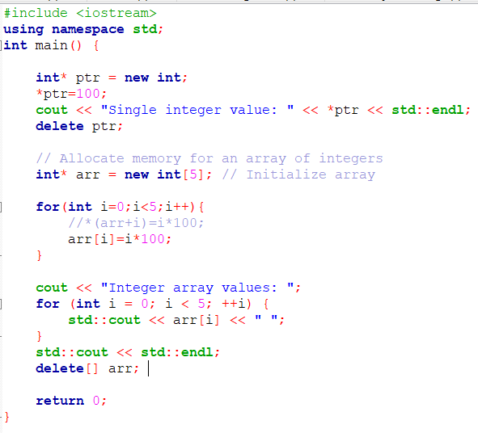
New and Delete
At first let us use it for primitive data types
Single variable
Array

Slide 18
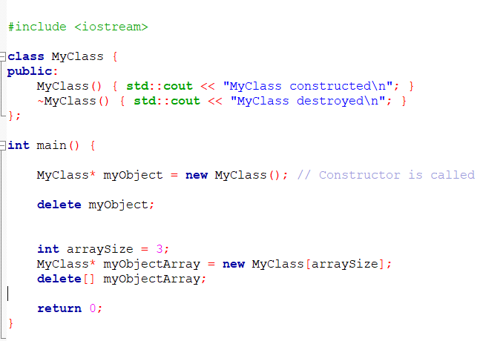
New and Delete
Now let us use it for objects
Single object
Array of objects

Slide 19
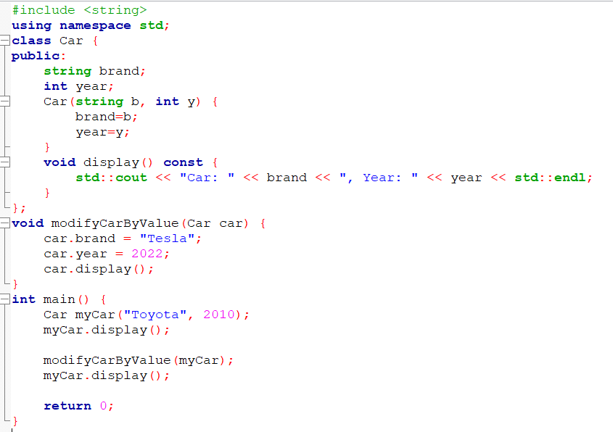
Passing Objects to Functions – by value
A copy of the object is made here
No changes will be made

Slide 20
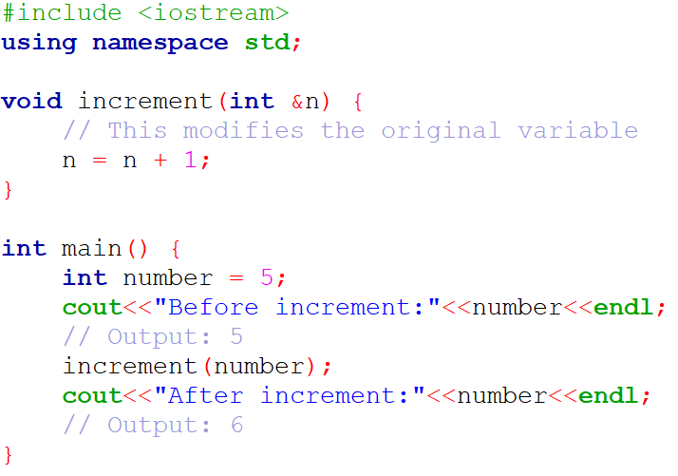
pass by reference
Reference of the variable is passed

Slide 21
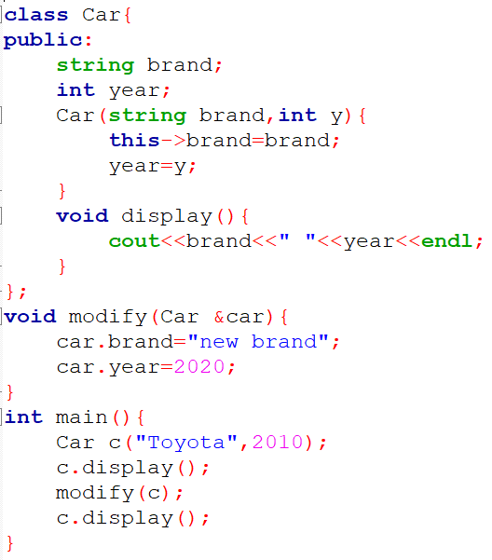
Passing Objects to Functions- pass by reference
The address of the object is passed here

Slide 22
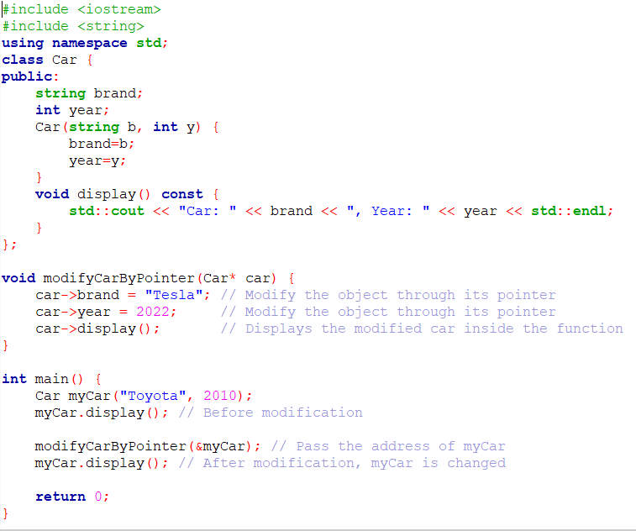
Passing Objects to Functions – using pointer
The address of the object is passed here

Slide 23
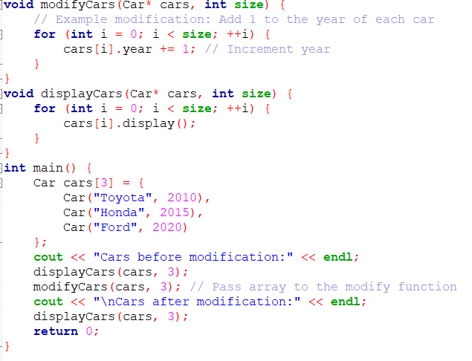
Passing an Array of Objects
Here the address of the first object of the array is passed

Slide 24
Templates in C++

Slide 25
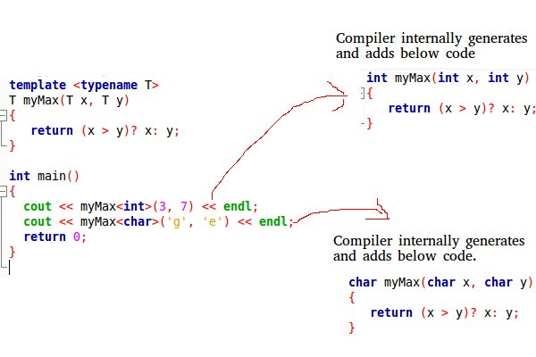
Template in C++
The simple idea is to pass the data type as a parameter so that we don’t need to write the same code for different data types.

Slide 26
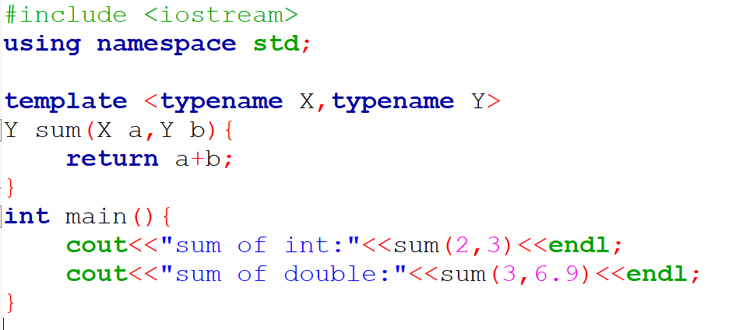
Templates in C++

Slide 27
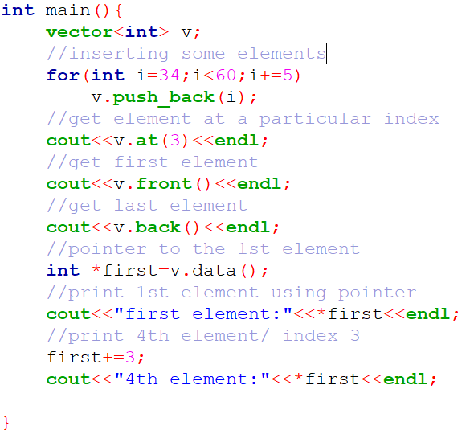
STL - Vector

Slide 28
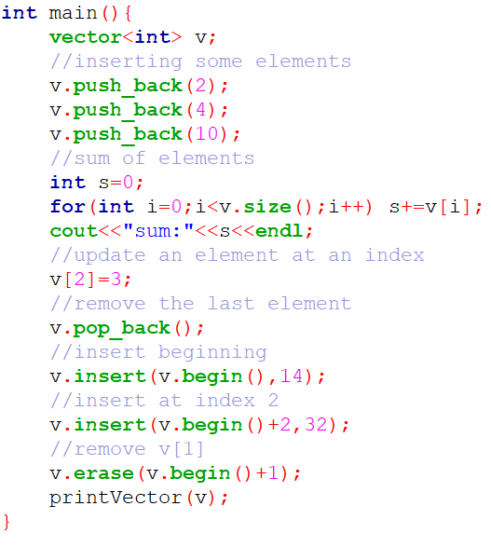
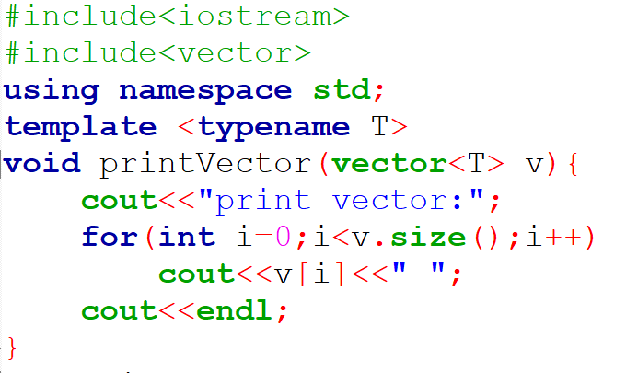
STL - Vector

Slide 29
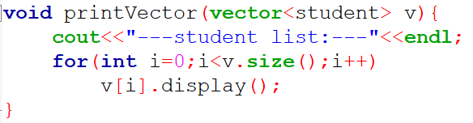
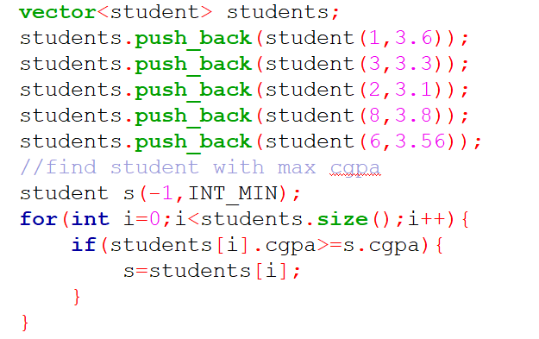
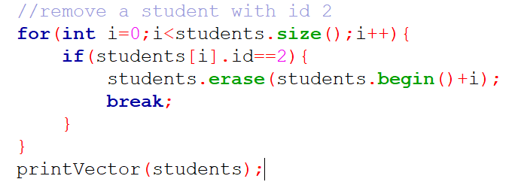
STL – Vector of class objects

Slide 30
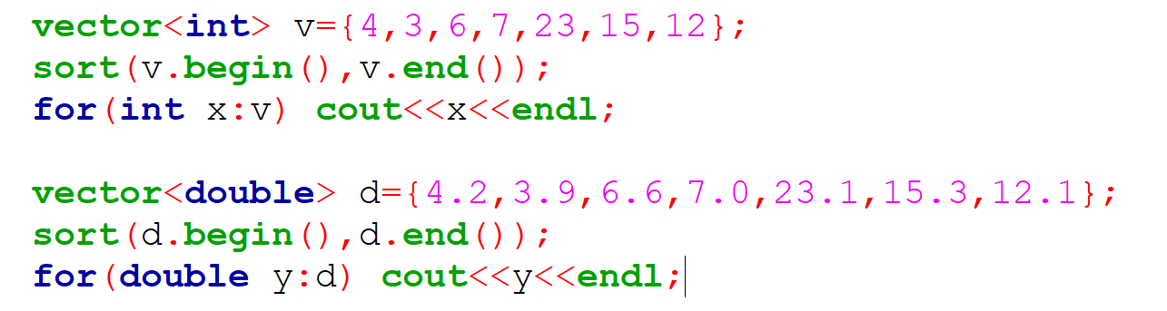
Sort vector

Slide 31
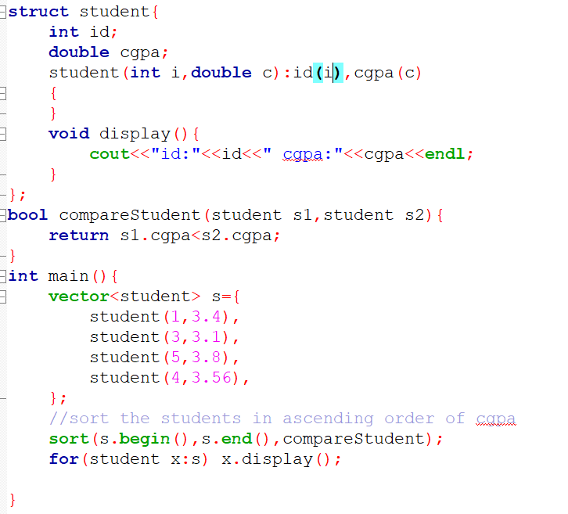
Sort vector of class objects/ structure

Slide 32
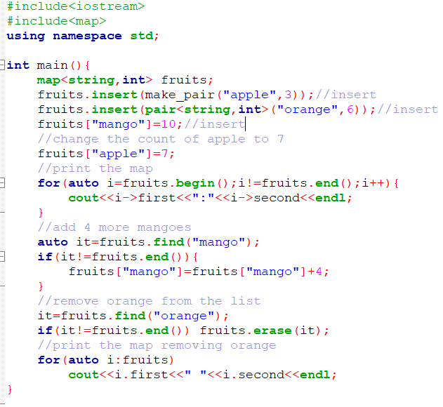
STL - MAP

Slide 33
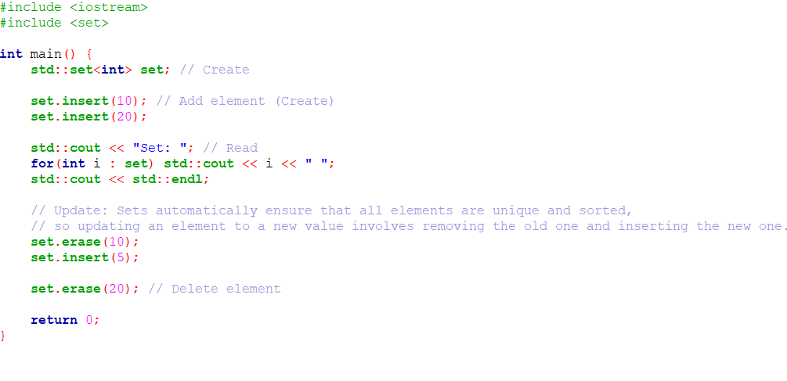
STL SET
CRUD

Slide 34
Thank you

